Slide 1

Welcome to the 4TU Git Workshop (day 2)

Slide 2
Program for today
10:00-12:30 – Git remotes (Github)
11:30-11:45- Break
12:30 – 13:30 – Lunch
13:30- 14:30 Collaboration
- Dealing with conflicts when working in the same project
14:30 – 14:45 Break I
14:45-17:00 Get to know 4TU.ResearchData
Using the 4TU.ResearchData data repository for your data management as a researcher.
15:45- 16:00 Break II
17:00 End of the workshop. Day 2

Slide 3
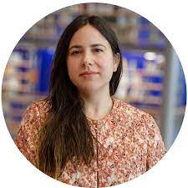
The team of the workshop
Instructor : Leila Inigo de la Cruz
Trainer at 4TU.ResearchData

Slide 4
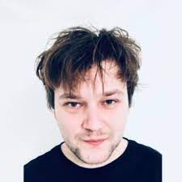
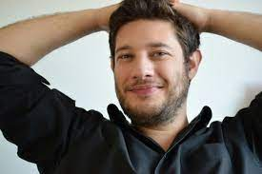
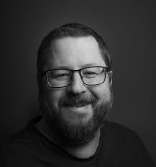
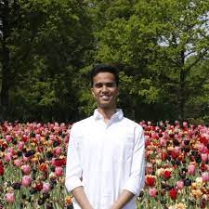
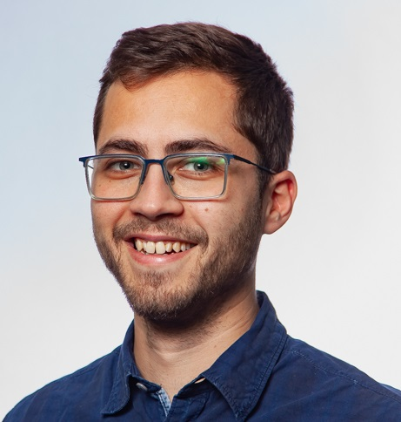
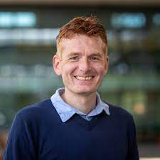
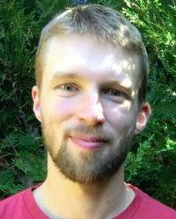
The team of the workshop
Samuel
UT-Lisa
Elvis
TU Delft
Helpers:
Joao
TU Delft
Halford
TU Delft
Jay
UT-ITC
John
TU/e
Bjorn
TU Delft

Slide 5
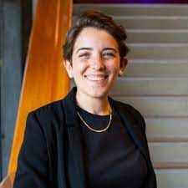
The team of the workshop
Host: Alessandra Soro
Community Manager at 4TU.ResearchData

Slide 6




The team of the workshop
YOU!

Slide 7

Code of conduct
The Carpentries teaches foundational coding, and data science skills to researchers worldwide.
Use welcoming and inclusive language
Be respectful of different viewpoints and experiences
Gracefully accept constructive criticism
Show courtesy and respect towards others during the workshop

Slide 8

Ice breaker
Write in the chat:
The email you used to make an account in Github.

Slide 9
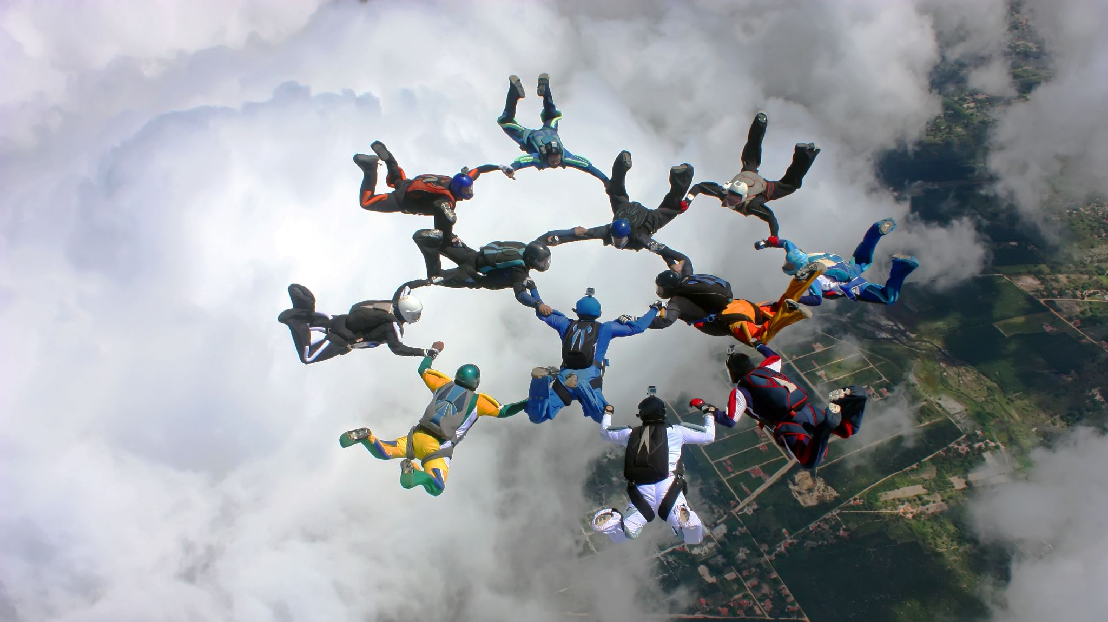
Enjoy!

